Slide 1
Nifty50 index price prediction by Machine Learning Technique.
Presented by: Dnyaneshwar Ainar

Slide 2
Introduction
Nifty50 is a popular stock index introduced by the National Stock Exchange(NSE) of India. The index is owned and managed by India Index Service & Products Limited (IISL). It was founded in 1992 while trading on Nifty was initiated in 1994. IISL is an Indian specialized company.
By investing in the NIFTY 50 index, you get to invest in 50 leaders in their sectors. So you give yourself a great chance to accumulate enormous wealth in the long run. And investing in the NIFTY 50 index can be convenient, easy, and cost-effective if you invest through index Mutual Funds.

Slide 3
Objective
Most important applications of Machine Learning in finance is Predicting the stock market.
Predicting the stock market has been the goal of investors since its inception. Every day billions of dollars are traded on the stock exchange, and behind every dollar is an investor hoping to make a profit in one way or another.
Entire companies rise and fall daily depending on market behavior. If an investor is able to accurately predict market movements, he can earn a higher rate of return will build wealth faster.
Some example of people who creates bigger wealth by investing in stock market is Warren Buffett, Rakesh Jhunjhunwala, Radhakrishnan Damani.

Slide 4
Today, so many people are making money staying at home trading in the stock market. It is a plus point for you if you use your experience in the stock market and your machine learning skills for the task of stock price prediction.
Let’s see how to predict stock prices using Machine Learning and the python programming language

Slide 5
Approach
Below mention are the steps involved in the completion of this project :
Collecting data.
Analyze and preprocess the dataset by using EDA technique.
Dividing the Dataset into training and testing sets.
Model selection.
Model Building.
Model Evaluation.

Slide 6
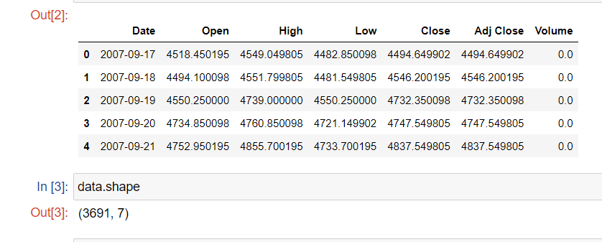
Data Collection
This dataset contains price of Nifty50 index currently trading on the Indian Stock Market.
Dataset downloaded from yahoo finance website.
Dataset contain 3691 rows and 7 columns.
We are using Nifty50 data between 2007 to 2022

Slide 7
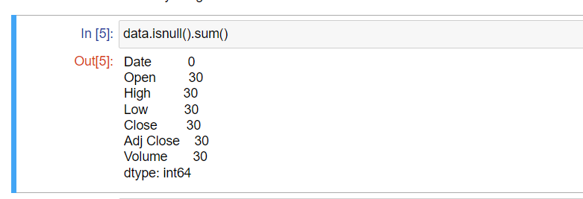
Data cleaning
Checking if any null values are present in the dataset.
The problem of missing value is quite common in many real-life datasets. Missing value can bias the results of the machine learning models and/or reduce the accuracy of the model.

Slide 8
Handling missing data:
Replacing With zero.
Replacing With mean.
Replacing With mode.
Replacing With median.
Deleting data.
Here, we have negligible missing values.
I am deleting the row in that missing value is present.

Slide 9
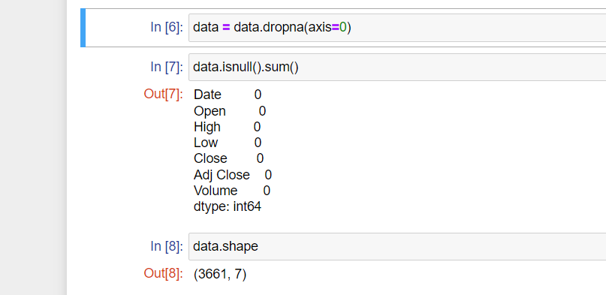
Axis = 0, for dropping rows.

Slide 10
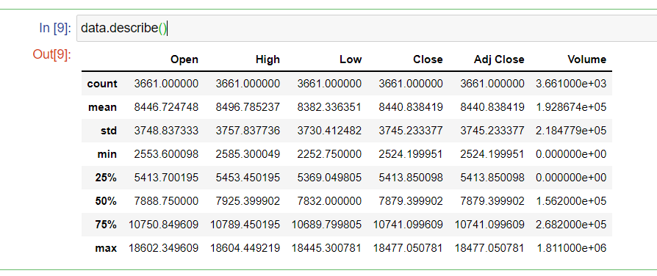
Summary Statistics
Here we take a look at the summary of each attribute. This includes the count, mean, the minimum and maximum values, standard deviation as well as some percentiles for numeric variables.

Slide 11
Exploratory Data Analysis(EDA)
Exploratory Data Analysis (EDA) is an approach to analyze the data using visual techniques. It is used to discover trends, patterns, or to check assumptions with the help of statistical summary and graphical representations.

Slide 12
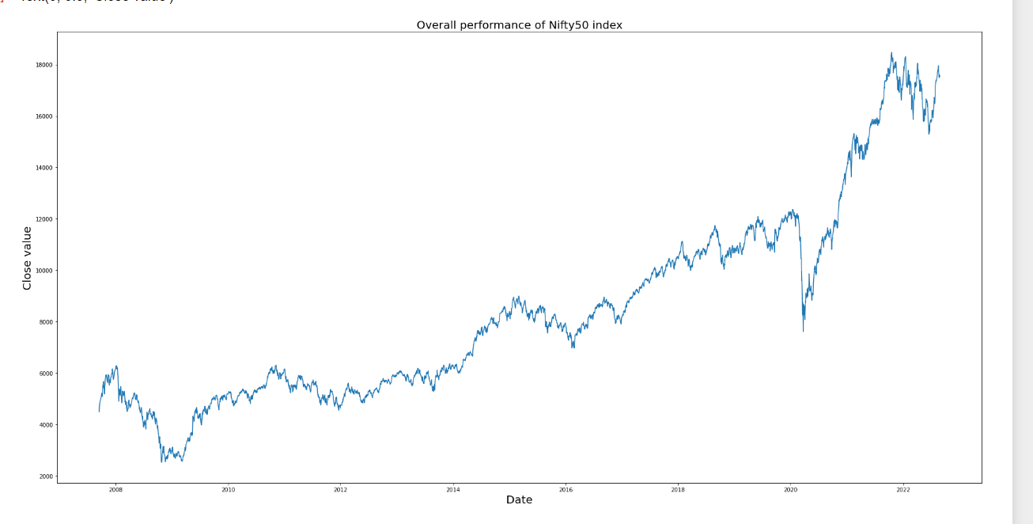
Visualize the close price Data: Overall performance of Nifty50 index over a period of time.

Slide 13
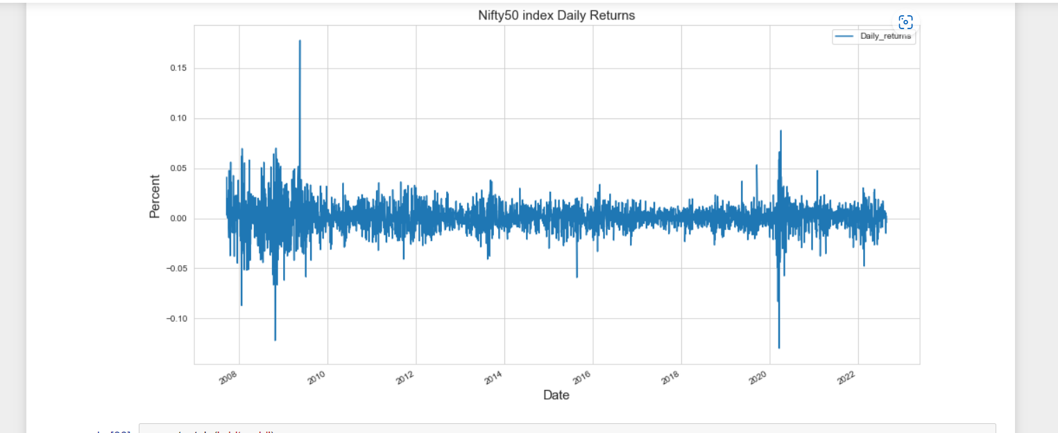
Nifty50 Daily Returns
pct_change(): python function to view daily percentage change on the basis of closing value.

Slide 14
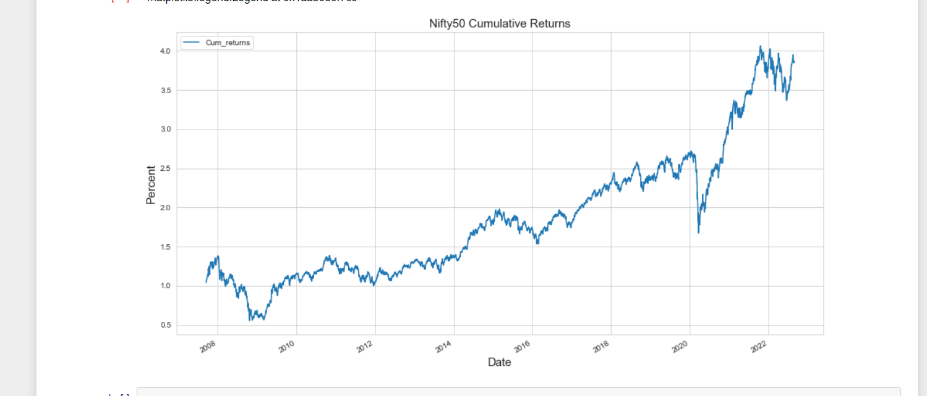
Nifty50 Cumulative Returns
The cumulative return is the total change in the stock / investment price over a set time.

Slide 15
Model selection
We have dependent variable in continuous and also want output to be continuous.
This is supervised machine learning task, there are two types of supervised ML problem, called Regression and Classification.
This dataset comes under Regression problem, as the target variable is continuous.
Regression: It is a supervised machine learning technique used if there is a relationship between the input/ Independent variable and the output / dependent/ Target variable.
Application of Regression: Weather forecasting, Market Trends, etc

Slide 16
Types of Algorithm comes under Regression:
Linear Regression
Decision Tree
Linear Regression:
Linear Regression: Linear regression is one of the easiest and most popular Machine Learning algorithms. Linear regression makes predictions for continuous/real or numeric variables such as sales, salary, age, product price, etc.
Linear regression algorithm shows a linear relationship between a dependent and one or more independent variables, hence called as linear regression.

Slide 17
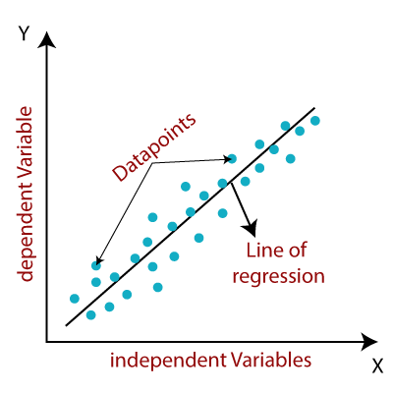
The linear regression model provides a sloped straight line representing the relationship between the variables. Consider the below image:

Slide 18
Decision Tree:
Decision Tree is a Supervised learning technique that can be used for both classification and Regression problems, but mostly it is preferred for solving Classification problems. It is a tree-structured classifier, where internal nodes represent the features of a dataset, branches represent the decision rules and each leaf node represents the outcome.

Slide 19

Below diagram explains the general structure of a decision tree:

Slide 20
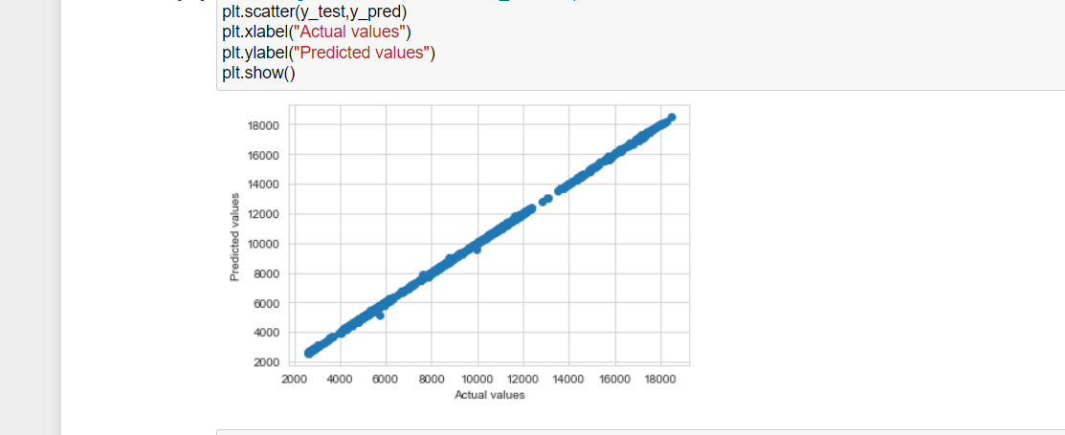
visualize the relation between predicted vs actual values

Slide 21
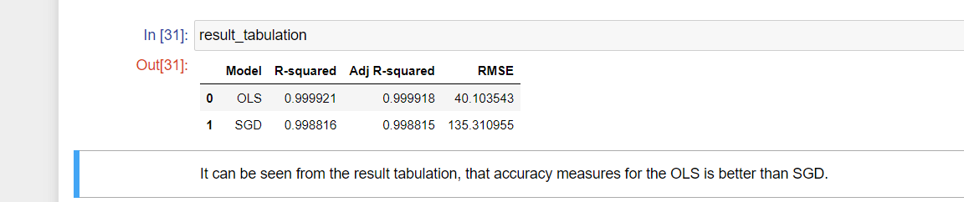
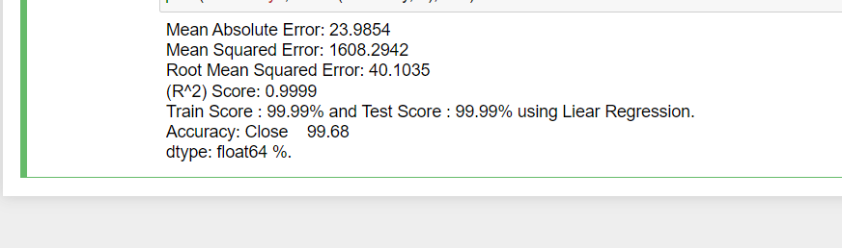
Model evaluation
Dfe

